Slide 1
Equivalent Fractions
Year 7
Week 4
Lesson 2

Slide 2
Last Lesson Recap
Notes:
• Share with students what they are learning or will be able to do
• Why the lesson is important

Slide 3
Lesson Objective
By the end of the lesson I will:
Know how to put fractions in order
Know what a fraction wall is

Slide 4
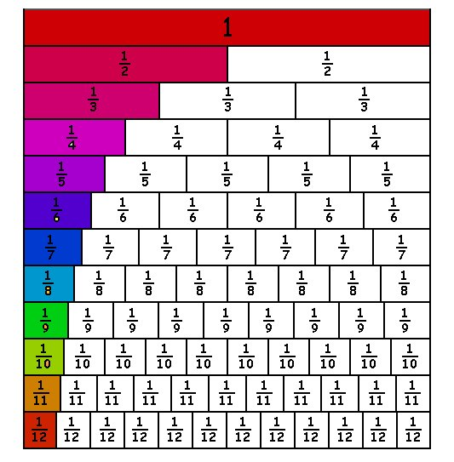
Take your fraction wall and fill it in
Add some colour to it like this one
Glue in your book

Slide 5
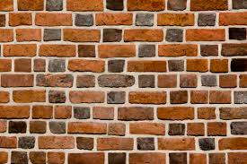
24
7
30
Topic: Fractions
Date
EQ – What is an equivalent fraction?
What is a fraction wall?
Fraction walls are useful for comparing fractions
1/2
3/4
5/6
8/10

Slide 6
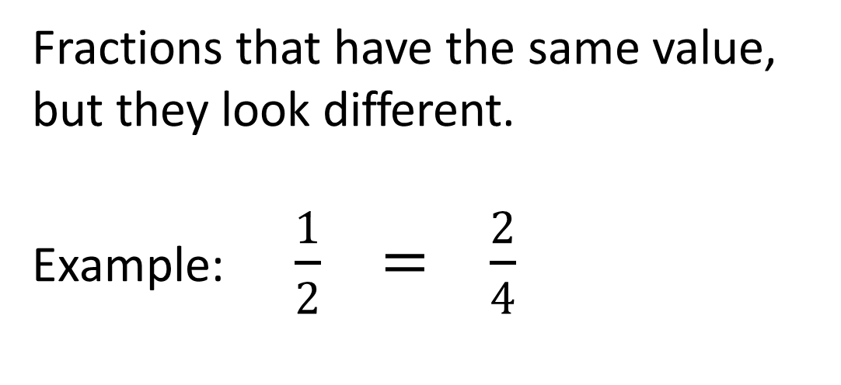
24
7
30
Topic: Fractions
Date
EQ – What is an equivalent fraction?
What is a fraction wall?
Fraction walls are useful for comparing fractions
What is a equivalent fraction?
Fractions that have the same value, but they look different.
Example: $\frac{1}{2} = \frac{2}{4}$

Slide 7
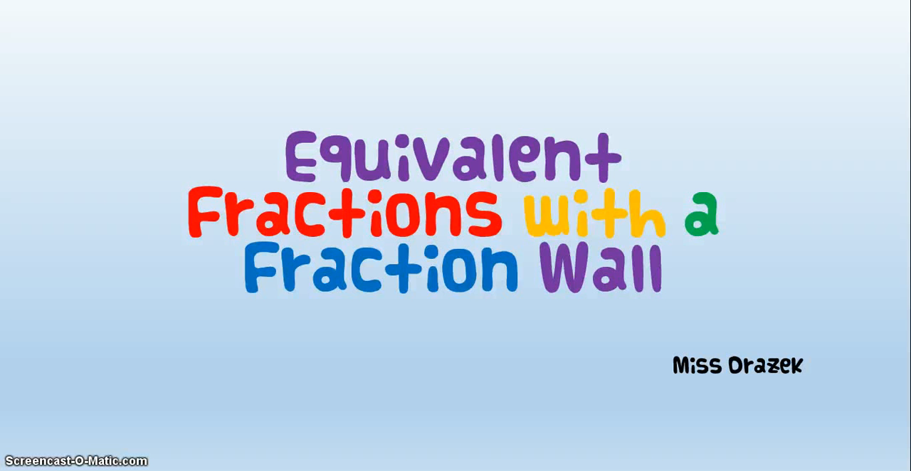

Slide 8
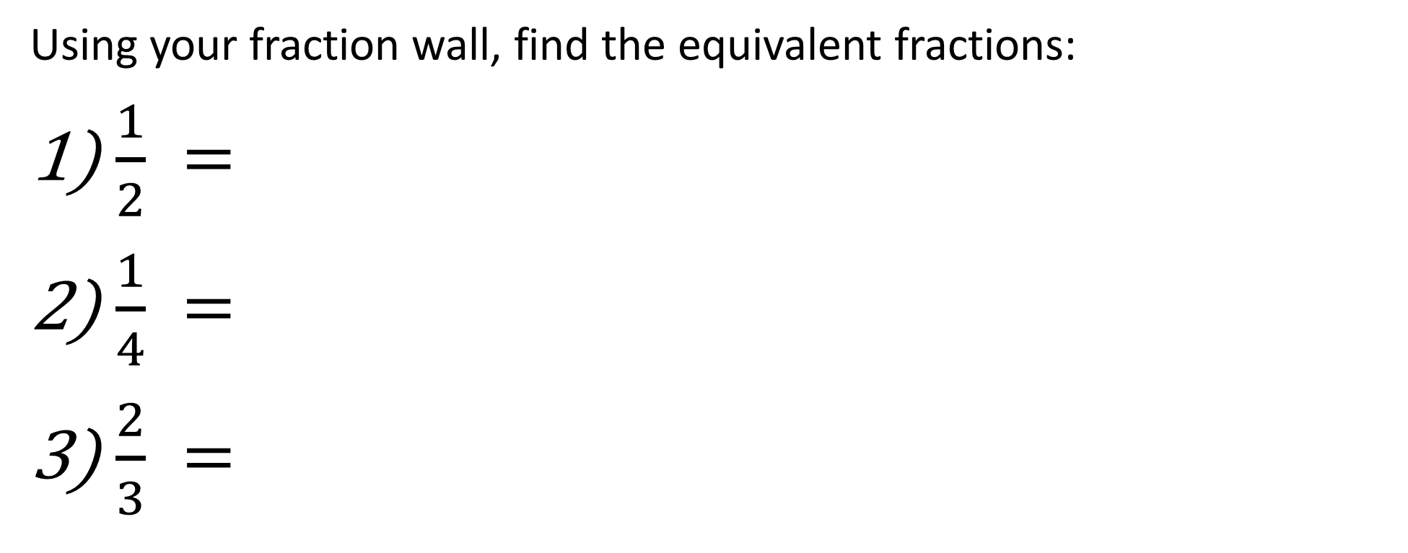
Examples
Using your fraction wall, find the equivalent fractions:
$\frac{1}{2} =$
$\frac{1}{4} =$
$\frac{2}{3} =$
Notes:
• Give students the opportunity to practise with teacher guidance
• Provide immediate and specific feedback with knowledge of results

Slide 9
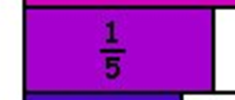
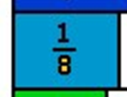
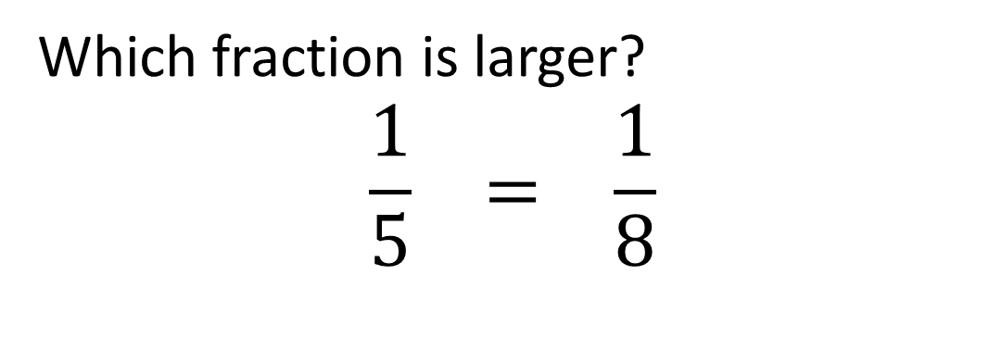
24
7
30
Topic: Fractions
Date
EQ – What is an equivalent fraction?
Which fraction is larger?
By using the fraction wall we can find out if a fraction is smaller or larger than other fractions
Which fraction is larger?
$$\frac{1}{5} = \frac{1}{8}$$

Slide 10
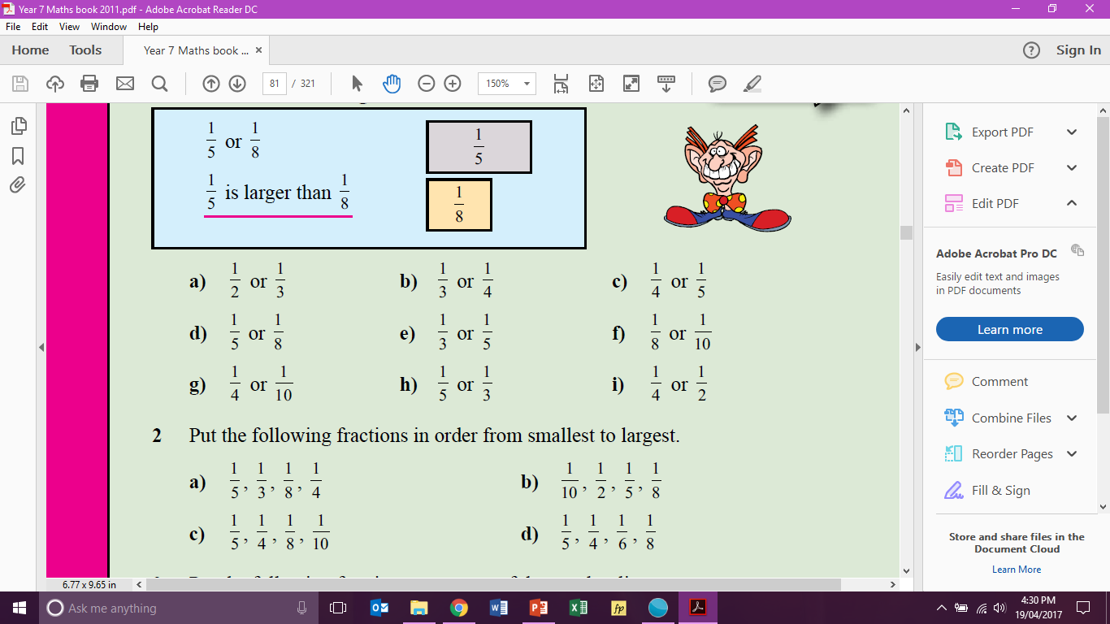
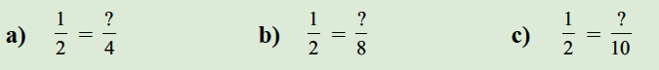
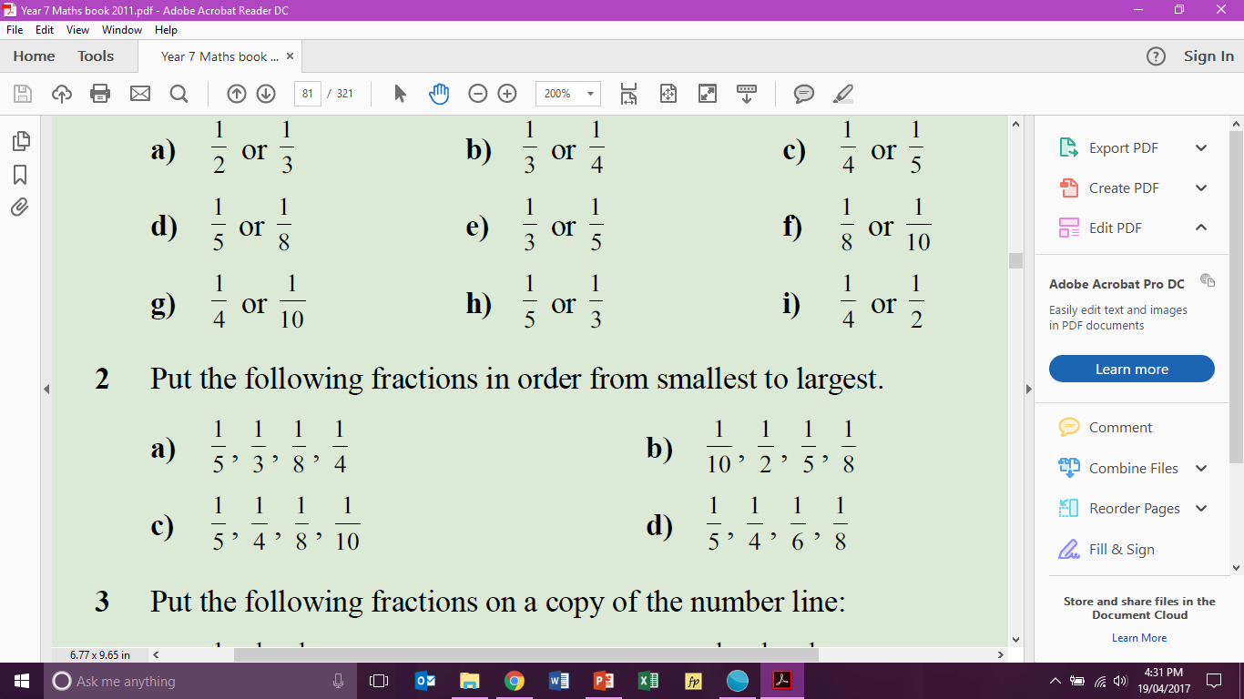
Task
Which fraction is larger?
Use your fraction wall to complete the following:
Put the following fractions in order from smallest to largest
Notes:
• Give students the opportunity to practise with teacher guidance
• Provide immediate and specific feedback with knowledge of results

Slide 11
Summary
Fill in your summary in your Interactive Notebook
Complete the Exit Ticket and give to me at the door when you leave

